Slide 1
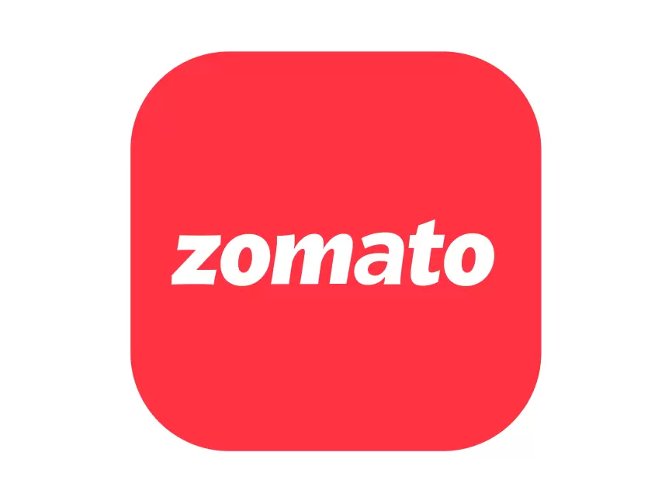
Zomato Order & Restaurant Analysis Using Power BI
Turning Data into Actionable Business Insights
Prepared by: Dhruv
Date: August 2025

Slide 2
Project Roadmap
Number of Restaurants per City
Percentage of Orders from Different Cities
Order Amount Trends Over Time
Correlation of Factors Affecting Average Rating
Top 5 Restaurants by Total Sales
Revenue by Area (Tree Map)
Order Density by City (Heat Map & Matrix)
KPI Cards – Total Revenue, Orders & AOV
Restaurant-Wise Sales Summary (Table)
Final Dashboard – Combined Insights

Slide 3
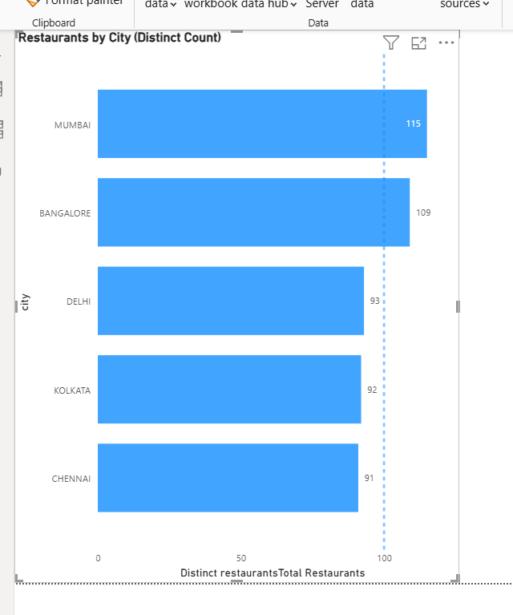
Task 1: Number of Restaurants per City
Objective:
Analyze the distribution of restaurants across the five cities to identify which have the highest and lowest restaurant presence.
Key Insights:
Mumbai (115) and Bangalore (109) have the largest share of restaurants, showing higher supply and food demand.
Delhi (93), Kolkata (92), and Chennai (91) are close in count, indicating a balanced distribution among them.
Overall, restaurant density is concentrated in metro cities, with relatively small variation between them.
Recommendations:
Strengthen partnerships and promotions in top metros (Mumbai, Bangalore).
Support growth initiatives in Delhi, Kolkata, and Chennai to balance market share.
Expand into Tier-2 and Tier-3 cities, where competition is lower and untapped demand exists.

Slide 4
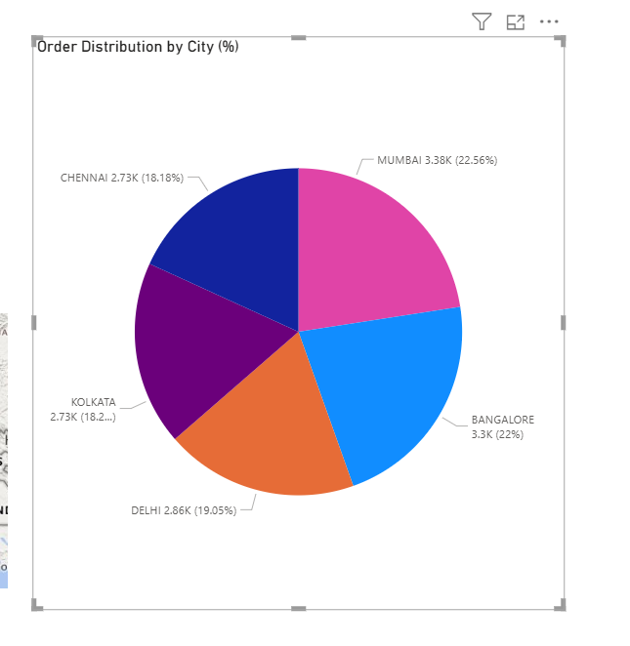
Task 2: Percentage of Orders from Different Cities
Objective:
Understand which cities contribute the most to total orders and how demand varies across regions.
Key Insights:
Mumbai (22.56%) and Bangalore (22%) are the top contributors, together accounting for nearly 45% of total orders.
Delhi contributes 19%, while Kolkata (18.2%) and Chennai (18.1%) show almost identical order volumes.
Order distribution is fairly balanced across the five cities, with no city showing extremely low demand.
Recommendations:
Prioritize customer retention and marketing in Mumbai and Bangalore, where order contribution is highest.
Leverage Delhi, Kolkata, and Chennai’s steady demand by running localized offers to push their share higher.
Explore Tier-2 and Tier-3 cities for future growth, as metro markets are already evenly saturated.

Slide 5
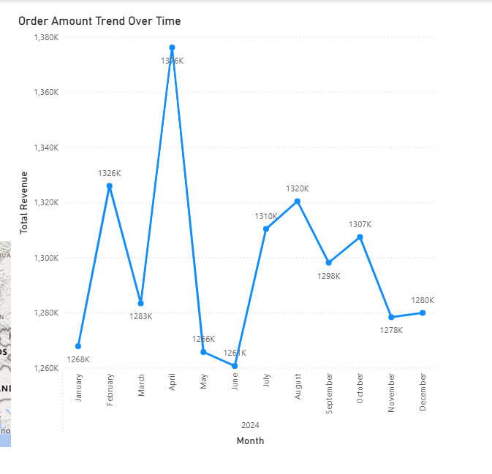
Task 3: Order Amount Trends Over Time
Objective:
Analyze how order amounts fluctuate over time to identify peak sales periods and slower months.
Key Insights:
Revenue peaked in April (1.38M), showing the highest sales during the year.
The lowest point was in June (1.26M), after a sharp decline from April.
Overall, revenue remains fairly stable between 1.26M–1.33M in most months, with only a few spikes/dips.
Recommendations:
Investigate April’s peak — likely seasonal demand (festivals, holidays) → replicate marketing strategies during similar periods.
Address the June dip by launching discount campaigns or promotions to balance demand.
Maintain consistent engagement strategies during stable months to sustain revenue baseline.

Slide 6
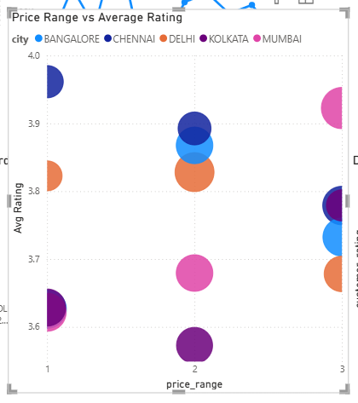
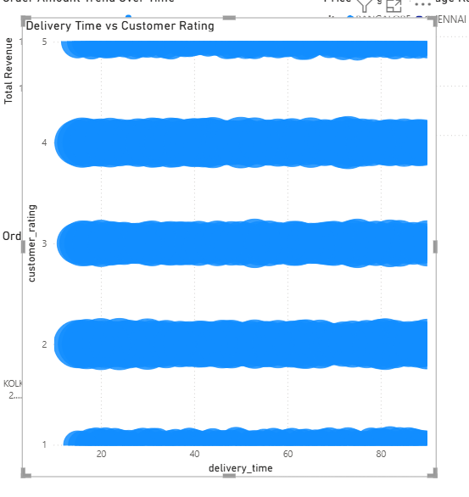
Task 4: Correlation of Factors Affecting Average Rating
Objective:
Identify how restaurant attributes (price range) and service factors (delivery time) influence customer ratings.
Key Insights:
Price Range vs Avg Rating: Higher-priced restaurants (premium band) show slightly better ratings on average, but variation exists within each band.
Delivery Time vs Customer Rating: Ratings are spread across all delivery times, with no strong negative correlation — suggesting food quality and service matter more than speed.
Across both plots, ratings are multi-factor driven, not determined by a single variable.
Recommendations:
Premium positioning works → Continue promoting higher-priced restaurants but ensure consistency in service to justify ratings.
Improve beyond speed → While fast delivery is important, invest in food quality, packaging, and order accuracy to drive better ratings.
Implement post-order feedback surveys to capture specific dissatisfaction reasons (e.g., late delivery vs food taste), enabling targeted improvements.

Slide 7
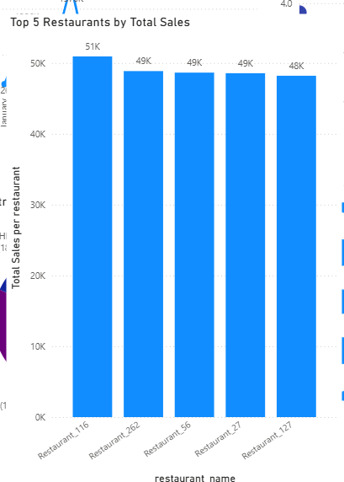
Task 5:Top 5 Restaurants by Total Sales
Objective:
Identify the highest-earning restaurants and analyze factors contributing to their sales performance.
Key Insights:
Restaurant_116 leads with the highest sales (₹50.9K), balancing strong order count and high average order value (~₹1,107).
Restaurant_262, 56, and 27 show similar sales (~₹48–49K) with slightly fewer orders but higher order values, reflecting premium positioning.
Restaurant_127 drives sales through highest order volume (50 orders) but lower average order value (~₹964), indicating a volume-based model.
Recommendations:
Strengthen partnerships with premium high-value restaurants that maintain high average order values.
Support volume-driven players like Restaurant_127 with promotions and loyalty offers to maximize repeat business.
Use Restaurant_116’s balanced model as a benchmark for sustaining both volume and value growth.

Slide 8
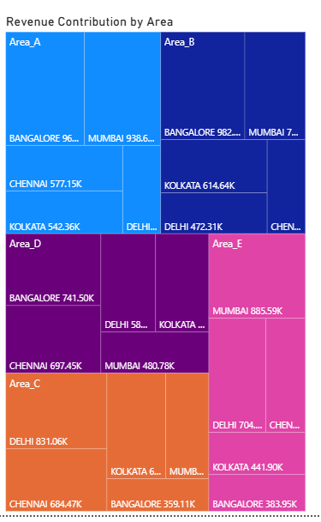
Task 6: Revenue by Area Using a Tree Map
Objective:
Analyze revenue distribution across different areas to identify high-performing and underperforming zones within cities.
Key Insights:
Area A contributes the highest share (22% revenue, ₹3.39M, 3,276 orders), with strong presence in Bangalore and Mumbai.
Areas B, C, and D each contribute around 20% revenue (~₹3.0M each), indicating balanced performance across these zones.
Area E lags slightly at 19% revenue (₹2.9M) despite comparable average order value (~₹1,044), suggesting relatively fewer orders.
Recommendations:
Strengthen customer engagement and campaigns in Area A to maintain leadership position.
Apply successful strategies from Area A (balanced order count + order value) to lift performance in Areas C, D, and E.
Investigate reasons for lower order volume in Area E (e.g., fewer partner restaurants, weaker delivery coverage) and address gaps with onboarding or localized offers.

Slide 9
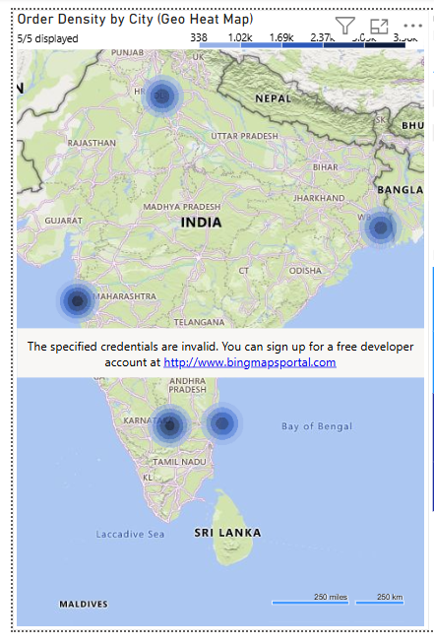
Task 7: Order Density by City Using a Heat Map
Objective:
Analyze order distribution across cities to identify regions with the highest and lowest demand.
Key Insights:
Mumbai (3,384 orders) and Bangalore (3,300 orders) lead in order density, together contributing nearly 45% of total demand.
Delhi (2,857 orders) shows moderate demand, slightly above Kolkata (2,732) and Chennai (2,727), which are close in volume.
Order distribution is relatively balanced across all five cities, though metro hubs (Mumbai & Bangalore) show stronger demand concentration.
Recommendations:
Prioritize capacity planning and partnerships in high-demand hubs like Mumbai and Bangalore to sustain order volumes.
Introduce targeted marketing campaigns in Delhi, Kolkata, and Chennai to lift their share closer to the top cities.
Explore Tier-2 city expansion, as metro markets are nearing saturation with evenly spread demand among top 5 cities.

Slide 10
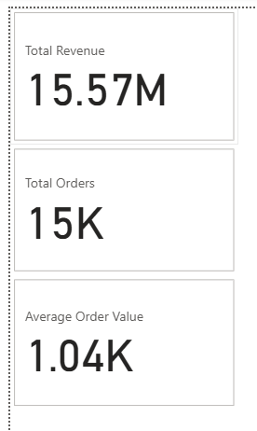
Task 8: KPI Cards – Total Revenue & Average Order Value
Objective:
Highlight key business performance metrics including revenue, total orders, and average order value for a high-level business overview.
Key Insights:
The platform generated ₹15.57M in total revenue from 15K orders, indicating strong market engagement.
The Average Order Value (AOV) stands at ₹1,040, showing customers spend consistently across cities.
A balanced ratio of orders to revenue suggests a stable pricing and order size distribution across the dataset.
Recommendations:
Continue focusing on increasing order frequency through loyalty programs to push overall revenue higher.
Explore strategies to raise AOV (₹1,040) via upselling combos, add-ons, or premium listings.
Benchmark revenue growth over time with these KPIs to monitor sustainability and expansion opportunities.

Slide 11
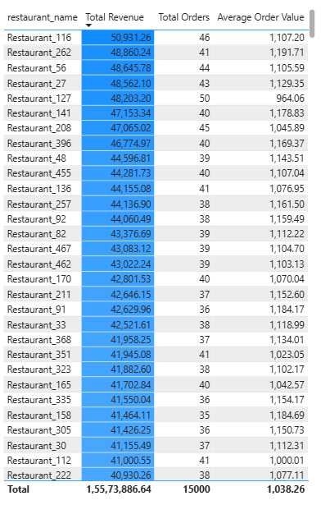
Task 9: Restaurant-Wise Sales Summary in a Table
Objective:
Summarize restaurant-wise performance in terms of revenue, orders, and average order value for easy comparison and analysis.
Key Insights:
Top restaurants (e.g., Restaurant_116, 262, 56, 27) generate ~₹49K–₹51K revenue with ~40–46 orders, showing strong consistency and customer engagement.
Restaurants with lower total revenue generally also have fewer orders, which may be due to newer onboarding or lower visibility, rather than poor performance.
Across the dataset, Average Order Value remains stable (~₹1,000–1,100), suggesting consistent pricing and customer spend across restaurants, regardless of order volume.
Recommendations:
Strengthen partnerships with high-performing restaurants by offering premium visibility and promotional support.
For restaurants with lower order counts, design onboarding and growth campaigns (discounts, visibility boosts) to accelerate customer adoption.
Maintain focus on AOV improvement strategies (combos, upselling) across all restaurants, since spend per order is relatively stable and can be increased gradually.

Slide 12
Summary of Insights & Recommendations
Key Insights:
Demand is concentrated in metro cities (Mumbai, Bangalore lead) but relatively balanced across 5 cities.
Revenue performance is driven by a few top restaurants, while many others show potential for growth.
Average Order Value is stable (~₹1,040) across restaurants, indicating consistent customer spending behavior.
Areas contribute almost evenly to revenue, with no extreme dependency on one locality.
Recommendations:
Strengthen partnerships & marketing in top-performing cities/restaurants to sustain growth.
Support new/low-order restaurants with promotions and visibility boosts to accelerate adoption.
Expand into Tier-2 and Tier-3 cities to unlock untapped demand and reduce reliance on metros.
Focus on AOV improvement via upselling, combos, and premium offerings.

Slide 13
